Slide 1

Introduction to Bibliometrics with Sci²
Ista Zahn and Steve Worthington

Slide 2
What is Bibliometrics?
Bibliometrics is the study of publications
Key techniques/tools include:
Co-authorship analysis
Co-citation analysis
Impact factors
Text/keyword analysis

Slide 3
Why Study Publications?

Slide 4
Map relationships among fields

Slide 5
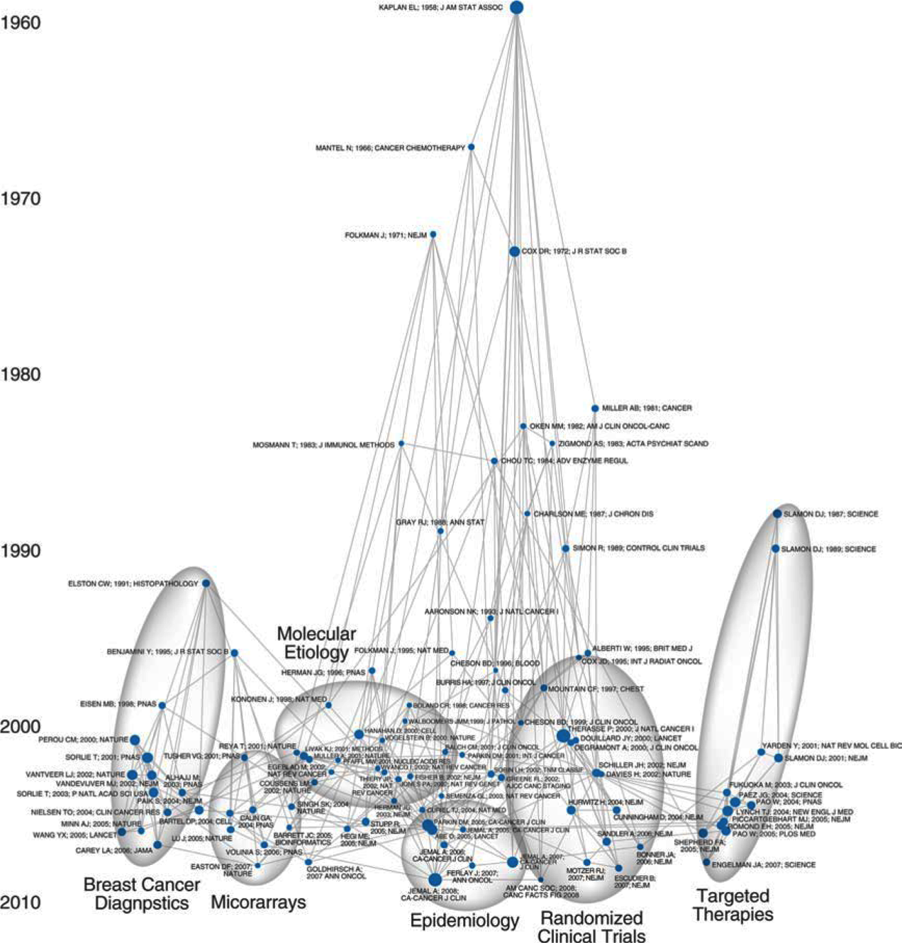
Map temporal trends
(e.g., in cancer publishing)

Slide 6
What Software Should I Use?
There are many alternatives, each with their own strengths and weaknesses
In this workshop we will focus on Sci², a program with a good balance of flexibility and ease of use
Refer to the handout for descriptions of alterative programs

Slide 7
Download Sci²
https://sci2.cns.iu.edu
Free registration required
Download then unzip
No need to install just run the sci2 executable from the unzipped sci2 directory

Slide 8
Analyses Available in Sci²
Temporal: When did activity occur?
Geospatial: Where did activity occur?
Topical: What occurred?
Network: How are entities related?

Slide 9
Workflow Overview
Obtain citation data to be analyzed
Load data in Sci²
Prepare and pre-process data: remove duplicates, extract networks, aggregate etc.
Analyze: burst detection, geocoding, clustering etc.
Visualize: Time series, geospatial, network

Slide 10
Example 1: Temporal Analysis
Examine trends in publications in the Journal “Scientometrics”
Main questions:
What are the trends in topics studied over time?
Who are the authors with the most longevity?

Slide 11
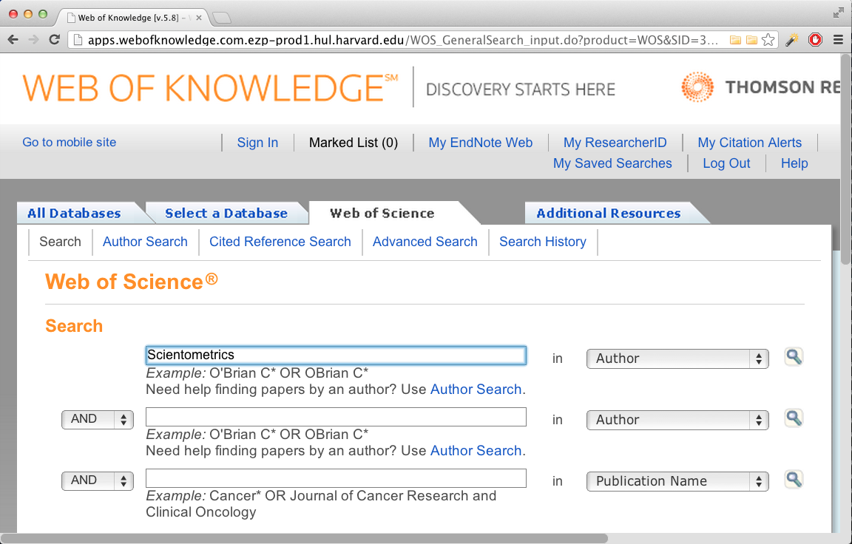
Locate Citations to be Analyzed
http://apps.webofknowledge.com.ezp-prod1.hul.harvard.edu/

Slide 12
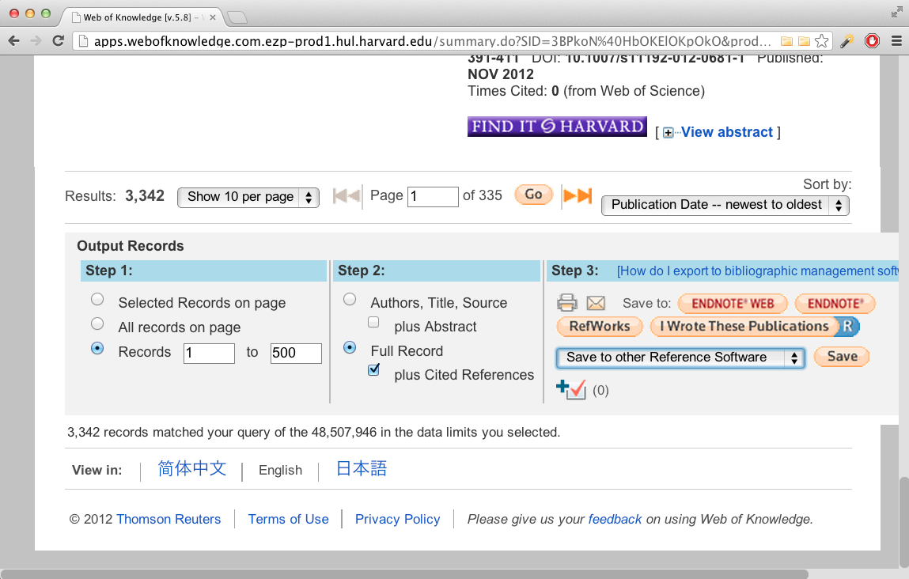
Download Citations
Download to a delimited plain text format
WoS only allows 500 records to be exported at a time

Slide 13
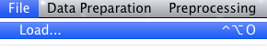
Rename and Load Saved Records
Rename the save records from “filename.txt” to “filename.isi”
If you have multiple record files, merge them
Load records in Sci²
Check console log for errors or warnings

Slide 14
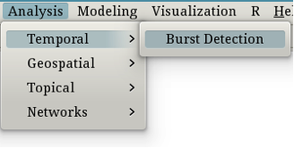
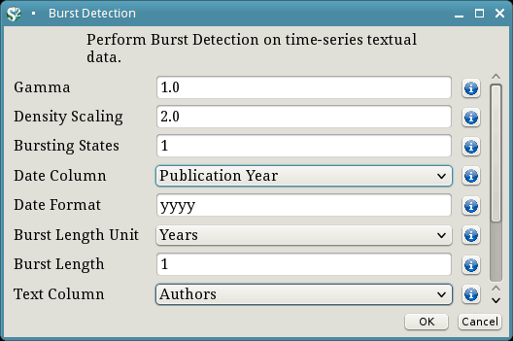
Temporal Analysis: Author Longevity
Burst detection for authors

Slide 15
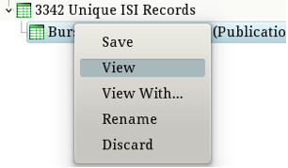
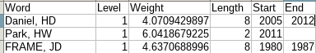
Clean Burst Detection Results
Often you will need to export data from Sci2, perform calculations/manipulations in another program, and reload the data
In this case we need to add the end date for authors who published in 2012

Slide 16
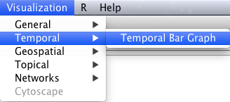
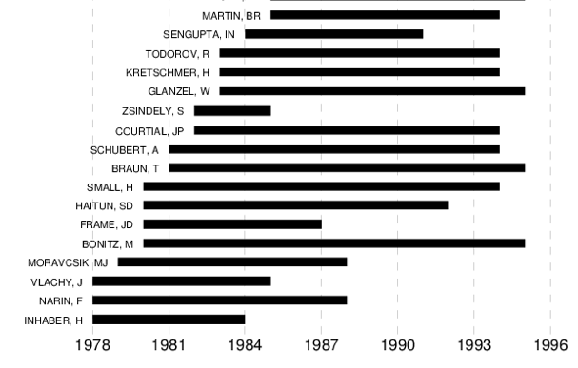
Plot Author Longevity

Slide 17
Your Turn!
Create a plot showing the temporal extent of Scientometrics article keywords

Slide 18
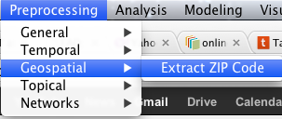
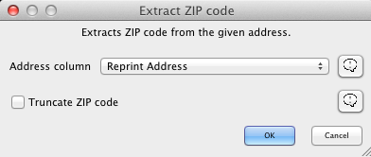
Geospatial Analysis: Corresponding Author Location
Examine origin of “Scientometrics” publications
Start by extracting zip codes:

Slide 19
Remove Extraneous Data
Open the data in a spreadsheet and remove all but the zip code column
Create a new column named “Records” and set all values to 1
Save the file and load it in Sci²

Slide 20
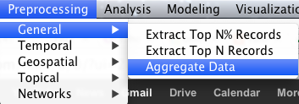
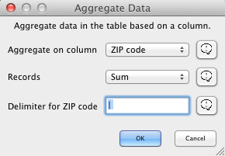
Aggregate Records by Zip Code

Slide 21
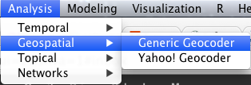
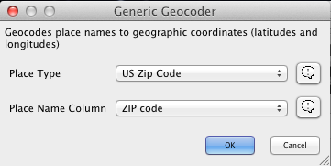
Extract Latitude and Longitude

Slide 22
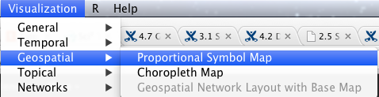
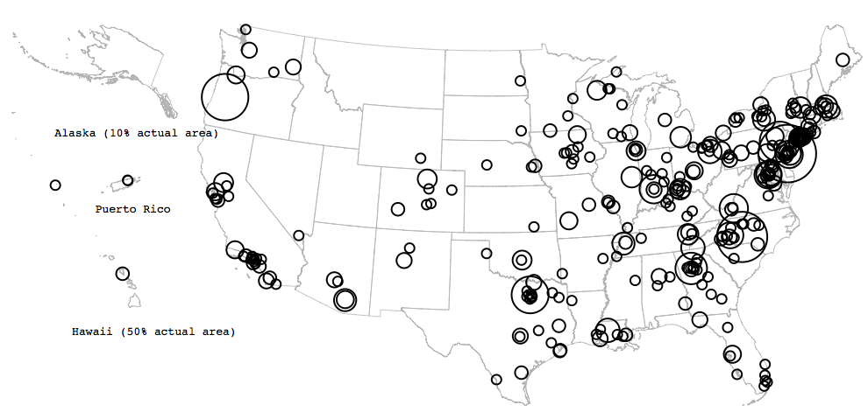
Visualize Article Origins

Slide 23
Your Turn!
Visualize influence (operationalized as number of times cited) by geographical location

Slide 24
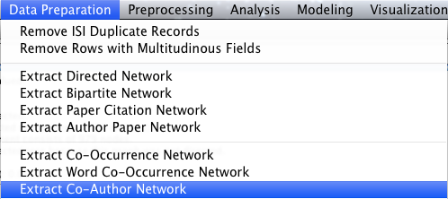
Network Analysis I: Co-Authorship
Networks consist of nodes and edges
Nodes represent entities (authors in this case)
Edges represent relationship (co-authorship in this case)
Co-authorship networks are used to visualize collaborative networks in an academic community
Start by extracting the co-authorship network:

Slide 25
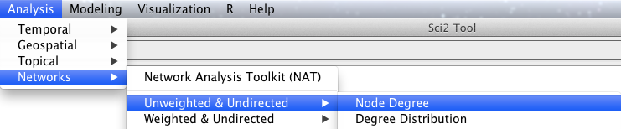
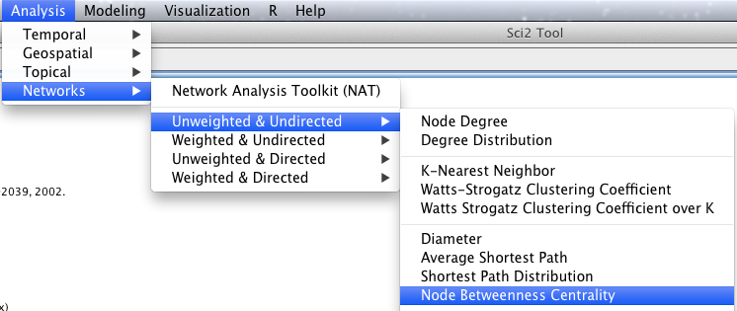
Calculate Node Attributes
The graph will be more interesting with attributes
Add degree (number of connections):
Add centrality (number of steps to other nodes):

Slide 26
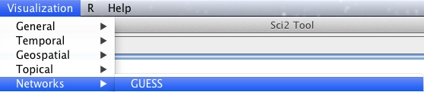
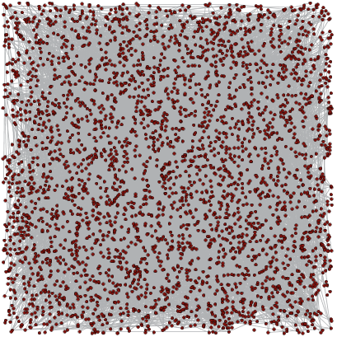
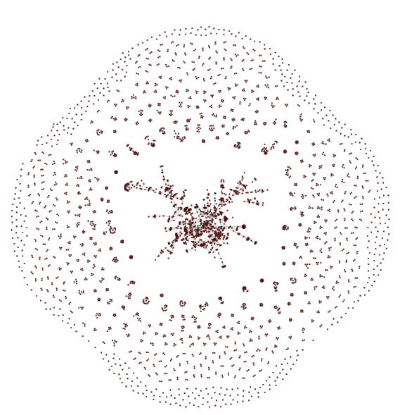
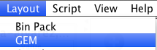
Graph Co-Authorship Network

Slide 27
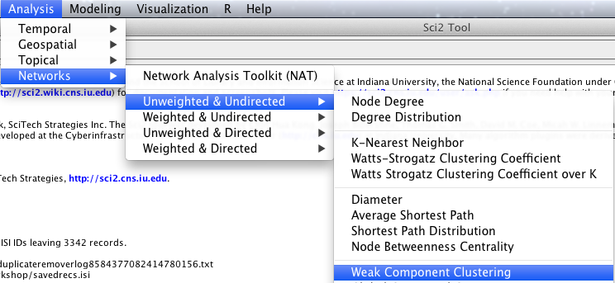
Focus On Main Cluster
The co-author network has one main cluster, with many smaller isolated cluster
The main cluster can be extracted using weak component clustering

Slide 28
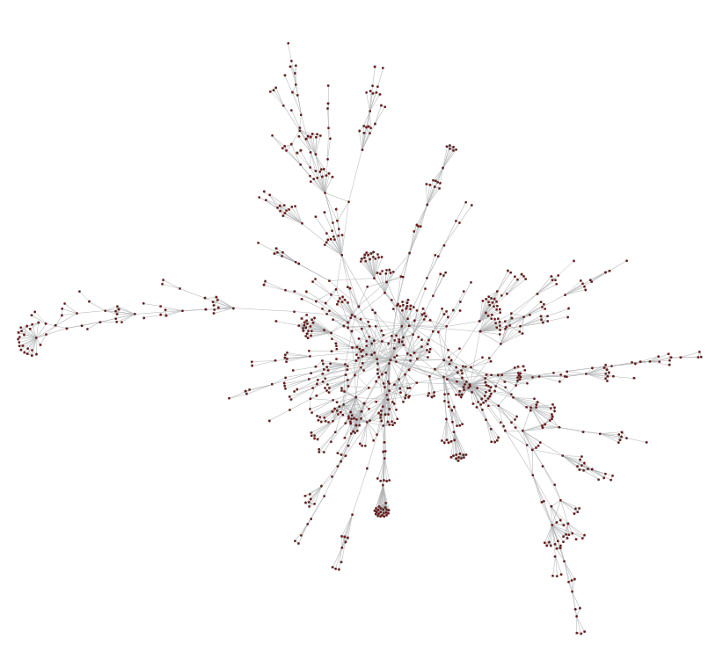
Graph Main Co-Authorship Cluster

Slide 29
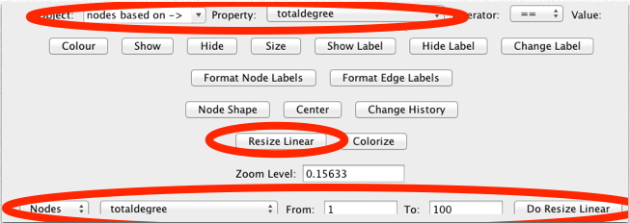
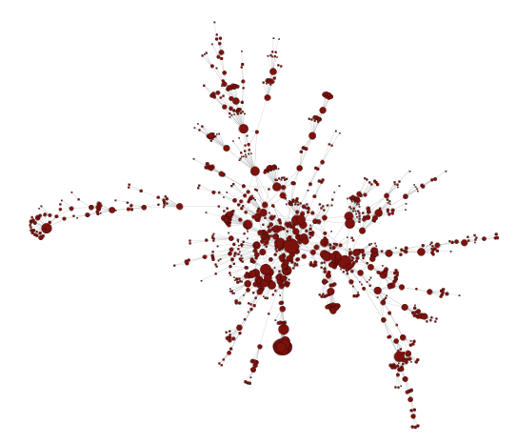
Add Author Attributes

Slide 30
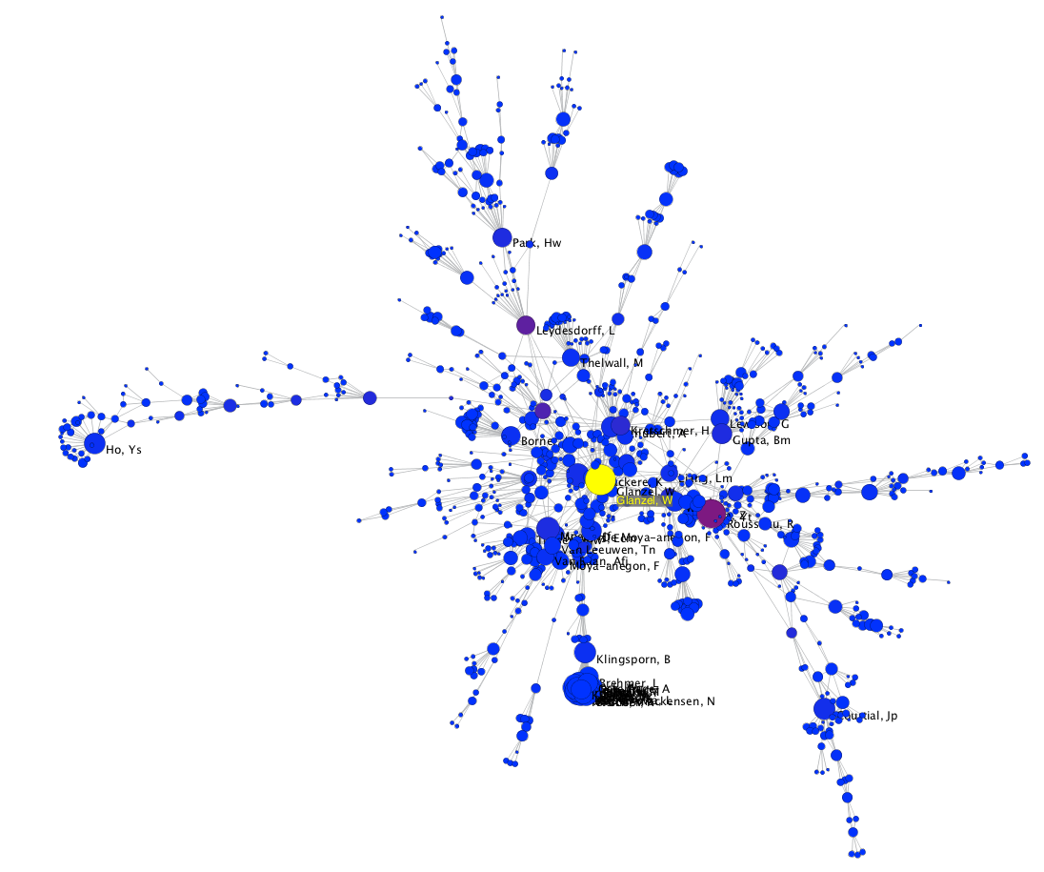
Final Co-Authorship Graph

Slide 31
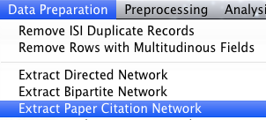
Network Analysis 2: Co-Citation
Co-citation analysis is a way of quantifying document similarity based on the number of times documents are cited together
Start by extracting a paper citation network

Slide 32
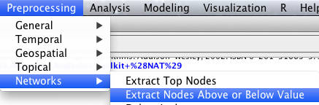
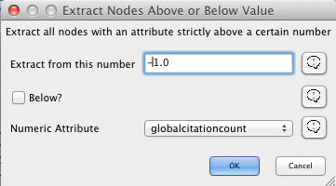
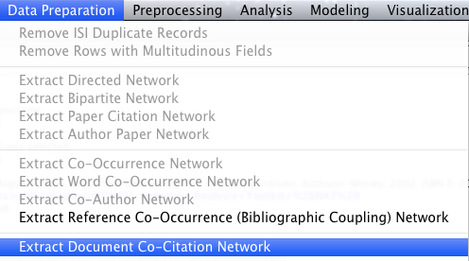
Extract Co-Citations for Documents Published In Scientometrics

Slide 33
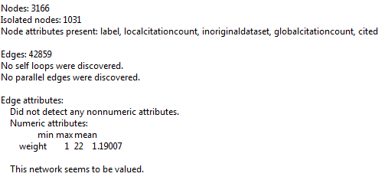
Layout And Visualize
The Co-citation network is very large:
Faster to layout the network with DrL

Slide 34
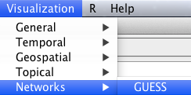
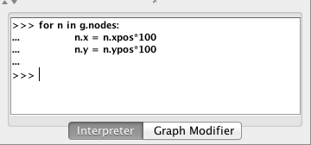
Visualize Co-Citations: Fix Layout
View the graph in GUESS
Increase node distance (in GUESS)

Slide 35
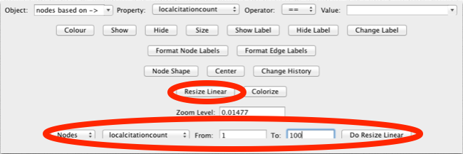
Visualize Co-Citations: Map Attributes
Resize nodes based on citation count

Slide 36
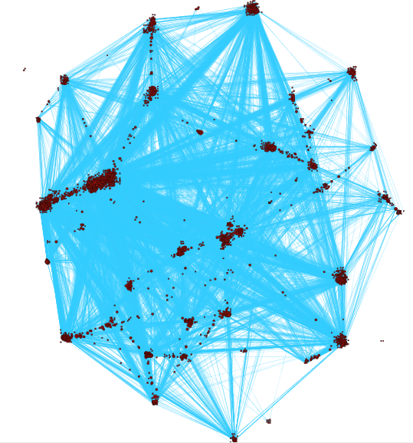
Visualize Co-Citations: Final Graph

Slide 37
Your Turn!
Extract and visualize a network of the co-occurrence of original keywords

Slide 38
Want More?
Sci² Documentation: https://sci2.cns.iu.edu/user/documentation.php
Harvard IQSS Research Technology Consulting
Our PhD consulting team serves Harvard's social science community, performing free in-person consulting on research issues as a part of the Institute for Quantitative Social Science
Send email to support@help.hmdc.harvard.edu
Refer to the course handout for alternative bibliometric software

Slide 39
Please Give Us Your Constructive Feedback
This is a new course, so your feedback is very important!
Please go to http://tinyurl.com/CitAn-feedback and tell us how we can improve

